Slide 1


– HubSpot + Shopify Integration
Overview
REDW provides financial solutions, accounting, audit, tax and wealth management services for individuals, mid-market companies and Tribal Nations.
They leverage Dynamics for CRM/sales as well as HubSpot for marketing. They were looking to implement a new Shopify ecommerce solution to their website that integrates with HubSpot and Dynamics.
Affirma Support
Set-up and configured net new Shopify account
Created custom header and footer as well as home, product, FAQ, cart and check-out pages
Created abandoned cart experience
Integrated Shopify and HubSpot
Established automated workflows for notifications, closed won deal creation and email deployment
Results

Slide 2
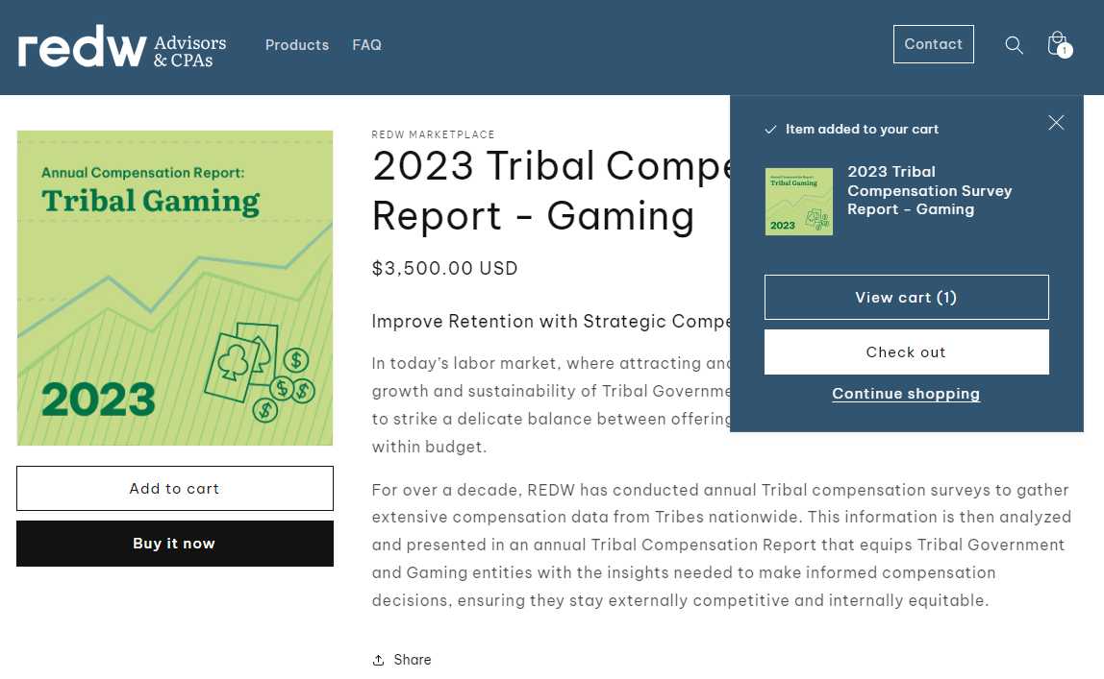
Shopping Cart Experience

Slide 3
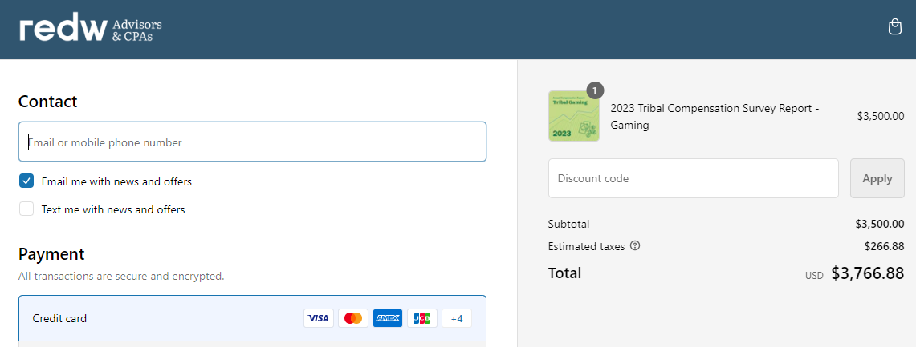
Check-Out Experience

Slide 4
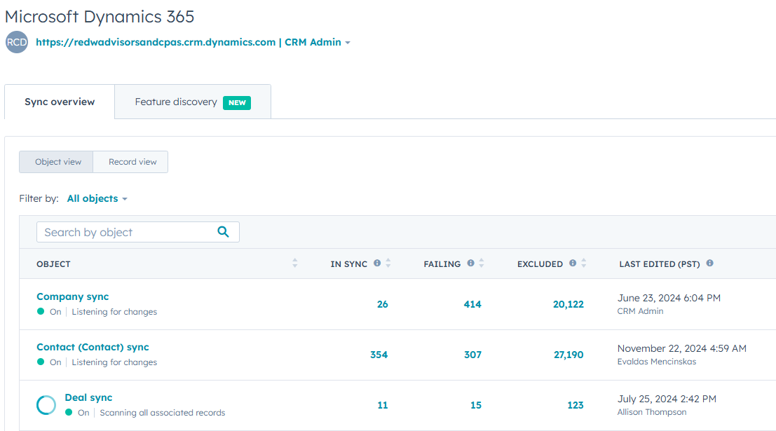
HubSpot, Shopify & Dynamics Integration
Overview
REDW provides financial solutions, accounting, audit, tax and wealth management services for individuals, mid-market companies and Tribal Nations.
They leverage Dynamics for CRM/sales as well as HubSpot for marketing. They were looking to integrate the two platforms as well as implement a new Shopify ecommerce solution to their website that integrates with HubSpot and Dynamics.
Affirma Support
Integrated Dynamics and HubSpot
Set-up and configured net new Shopify account
Created ecommerce webpages
Created abandoned cart experience
Integrated Shopify and HubSpot
Established automated workflows
Training

